Slide 1
VG-15 APP
Done By: Goh Rui Zhuo (2222329)

Slide 2
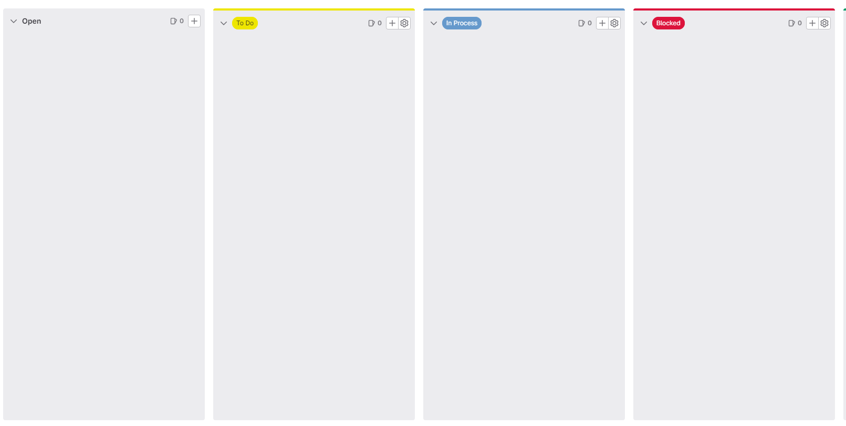
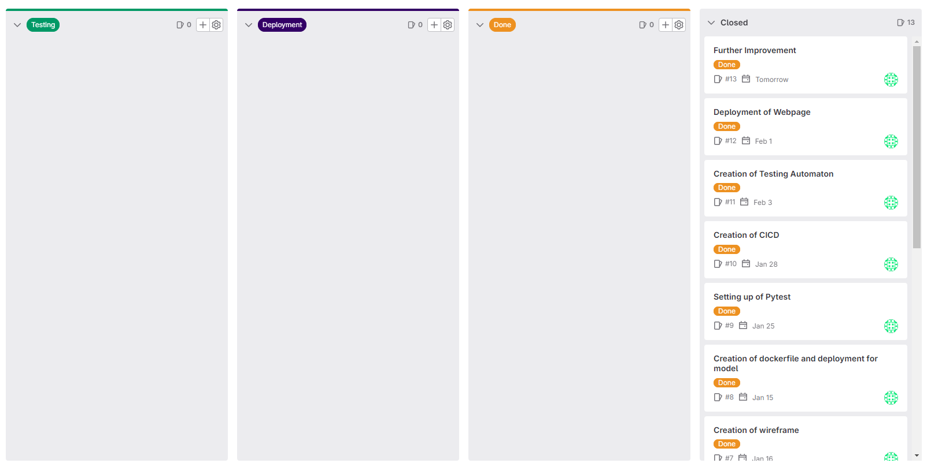
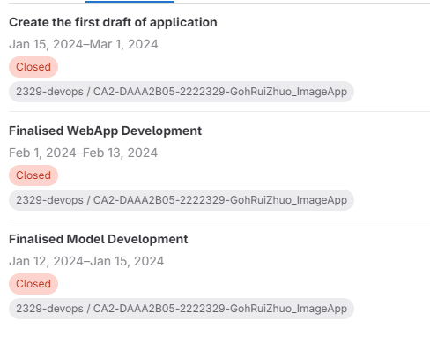
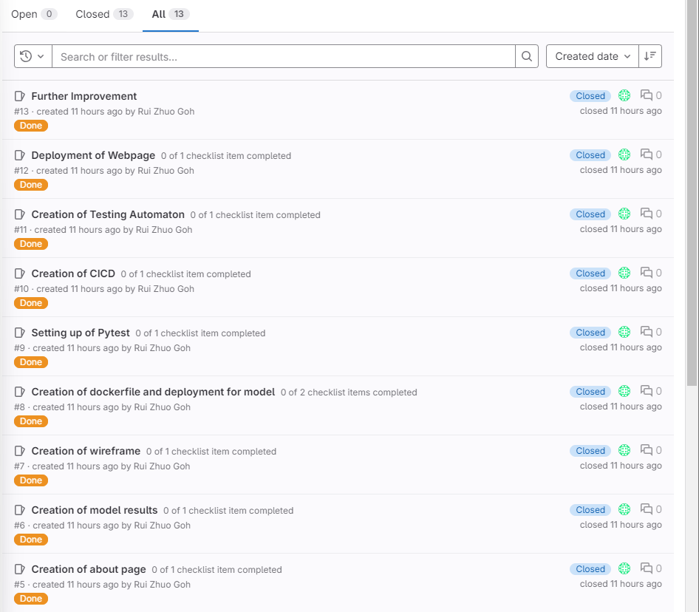
Scrum Board
Added six section which are
To Do
In Process
Blocked
Testing
Deployment
Done
Milestones created (Sprint)
13 overall issue boards

Slide 3
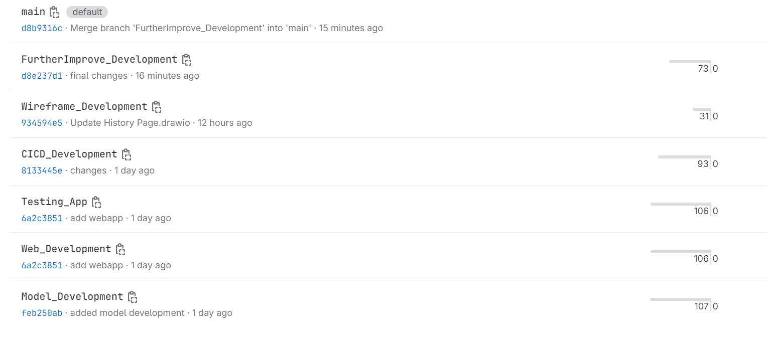
Branches Created
6 separate branches were created

Slide 4
Image Model Development
**All models and webapp are done in docker container
Model Creation
Baseline Dense Model (31 x 31 model)
CNN Baseline 1 Model ( 31 x 31 model)
CNN Baseline 2 Model (128 x 128 model)
Initial Convolutional Block
Three more convolutional block
1 dense layer
Custom VGG 16 model (128 x 128 model)
Increase of layers
Starts at a lower number of filters
Change in conv block (reduce to 3 from 5)
Added regularisation
And many others…

Slide 5
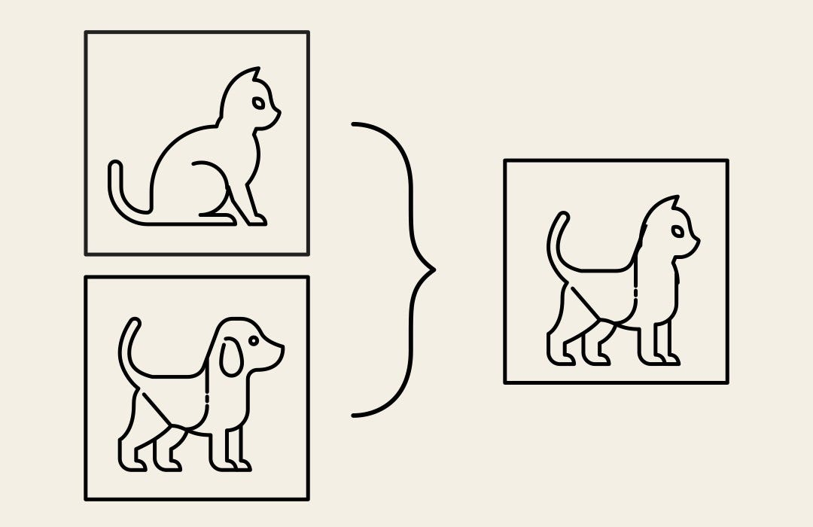

Image Model Improvement
Special Techniques for data augmentation
CutMix
Cut and paste random patches between the training images/
CutOut
Cut out certain parts of the image and input black parts onto it
Image Data Generator
Random rotating here

Slide 6
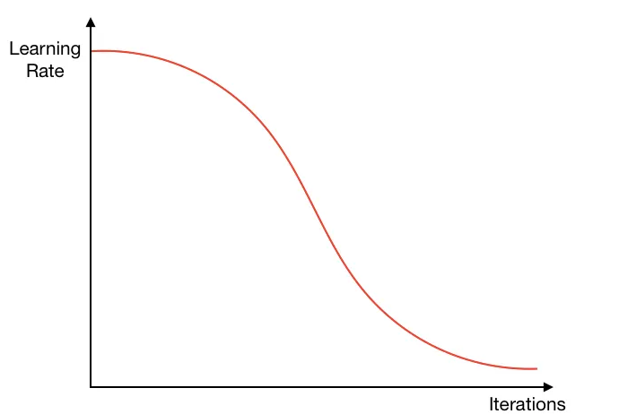
Image Model Improvement
Learning Rate Scheduler
Idea is to adjust the learning rate as the iterations increases
Start out with relatively high learning rates for several iterations in the beginning to quickly approach a local minimum
Then gradually decrease the learning rate as we get closer to the minimum, ending with several small learning rate iterations
Goal of neural network is to find the minimum of the loss function hence this is important to not let the model skip the minimum point

Slide 7
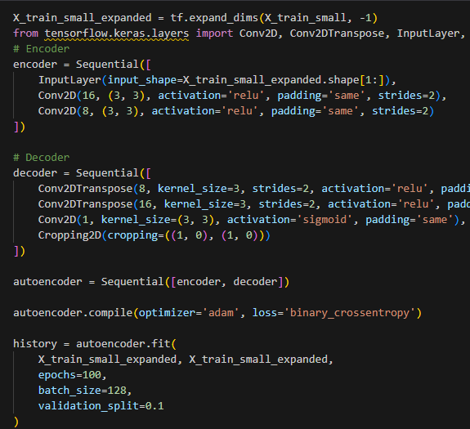
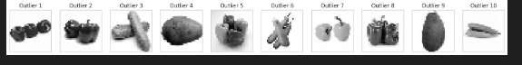
Image Model Improvement
128 x 128 and 31 x 31 Images (Auto Encoder)
With autoencoder, we try to remove the outliers from the dataset
Below shows the separation of the data and only non outliers was use in training of model
However, for both image size, the validation score did not improve likely due to the images being very clear and concise

Slide 8
Image Model (Final)
31 x 31 Images
Best Model: CNN1 with cutmix
Achieved 97.2 validation and test accuracy
Model is best at prediction Bottle Gourd and worst at Potato in terms of f1 score
Cohen Kappa score is also at 97%
128 x 128 Images
Best Model: CNN2 with cutmix
Achieved 99.2 validation and 98.8 test accuracy
Model is best at prediction Bottle Gourd and worst at Radish in terms of f1 score
Cohen Kappa score is also at 98.75%

Slide 9
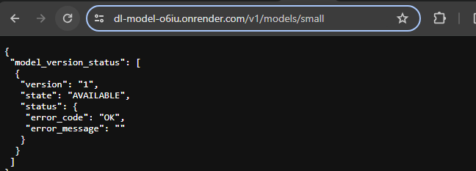
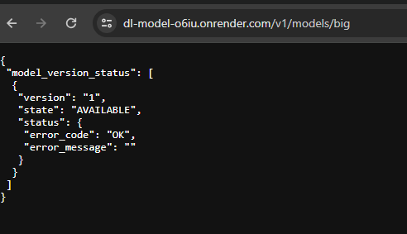
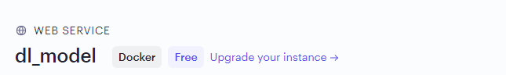
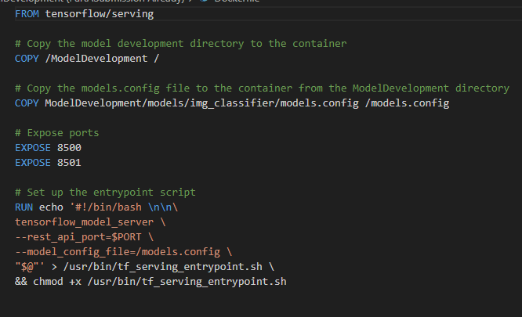
Model (Final with Deployment)
31 x 31 Images
Best Model: CNN1 with cutmix
Achieved 97.2 validation and test accuracy
Model is best at prediction Bottle Gourd and worst at Potato in terms of f1 score
Cohen Kappa score is also at 97%
128 x 128 Images
Best Model: CNN2 with cutmix
Achieved 99.2 validation and 98.8 test accuracy
Model is best at prediction Bottle Gourd and worst at Radish in terms of f1 score
Cohen Kappa score is also at 98.75%

Slide 10
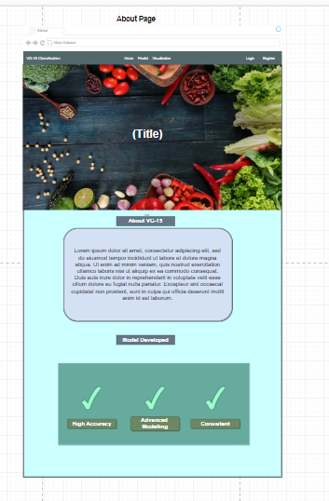
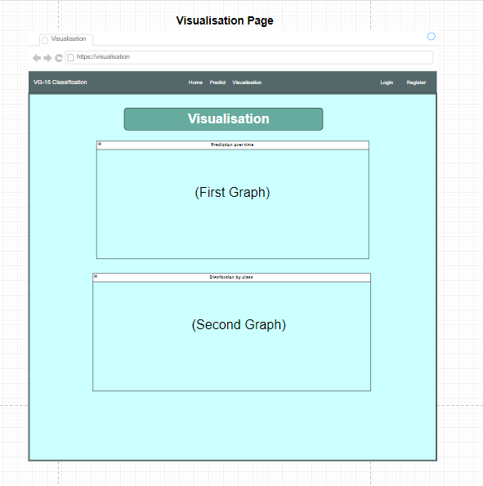
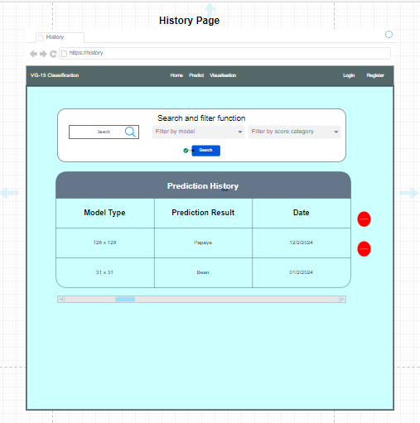
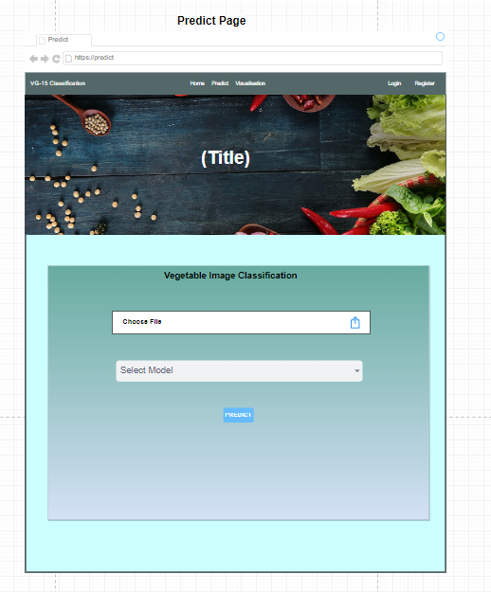
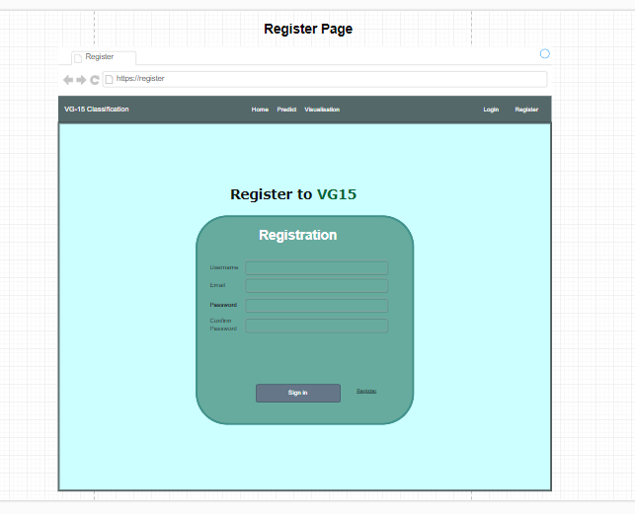
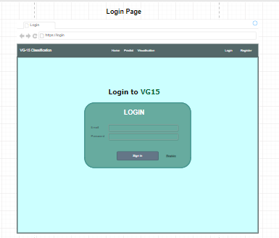
Wireframes
Clean and concise design were used here

Slide 11
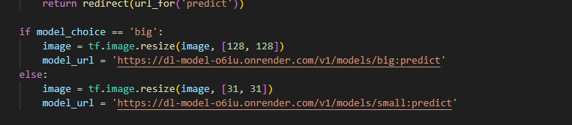
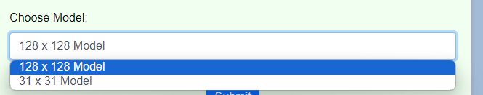
Deploying two Models
Deploy two models for user
Models can be switch with the use of dropdown menu

Slide 12
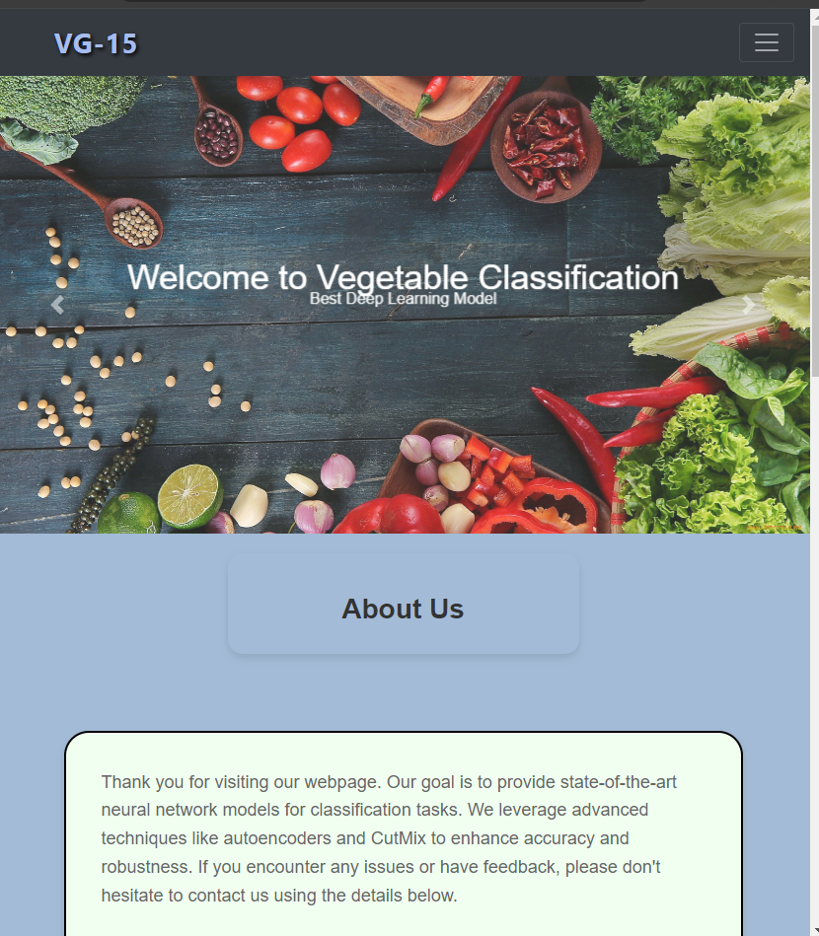
Web Development (Home)
Home page design with the use of vegetable images here
Added an introduction
Provided idea of our model

Slide 13
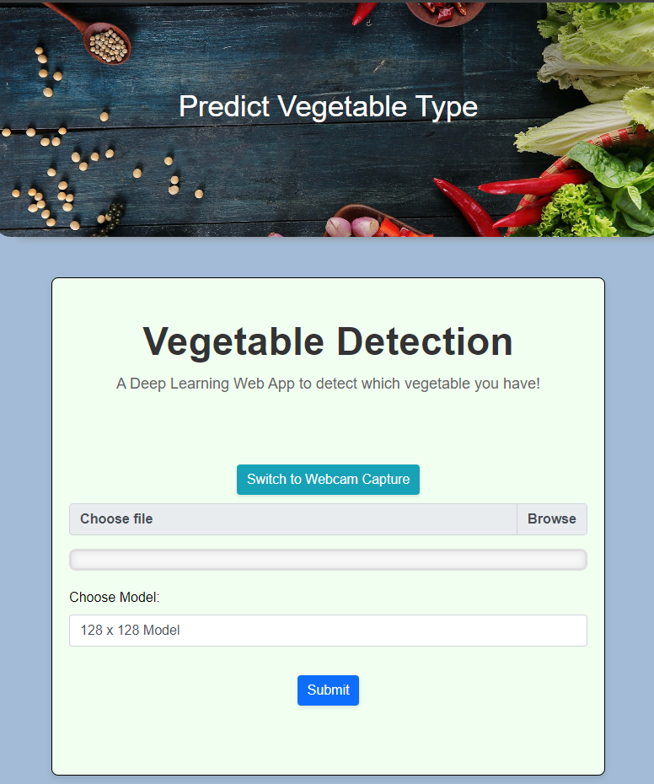
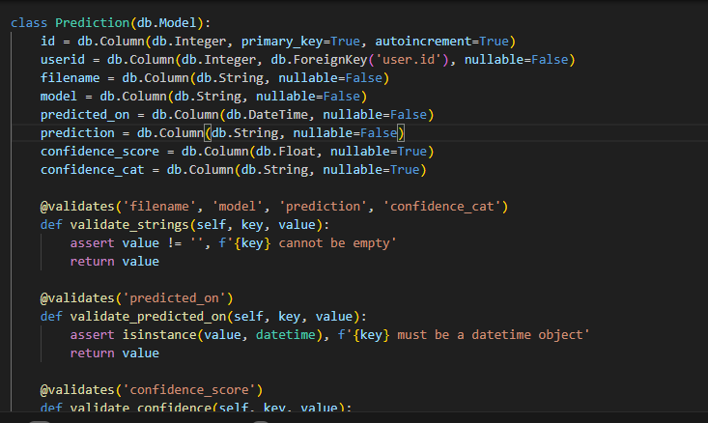
Web Development (Predict)
Prediction page was designed with the idea of providing user to seamless switch between models
Provide user input which is the upload of models here
Deployed with the use of flask framework

Slide 14
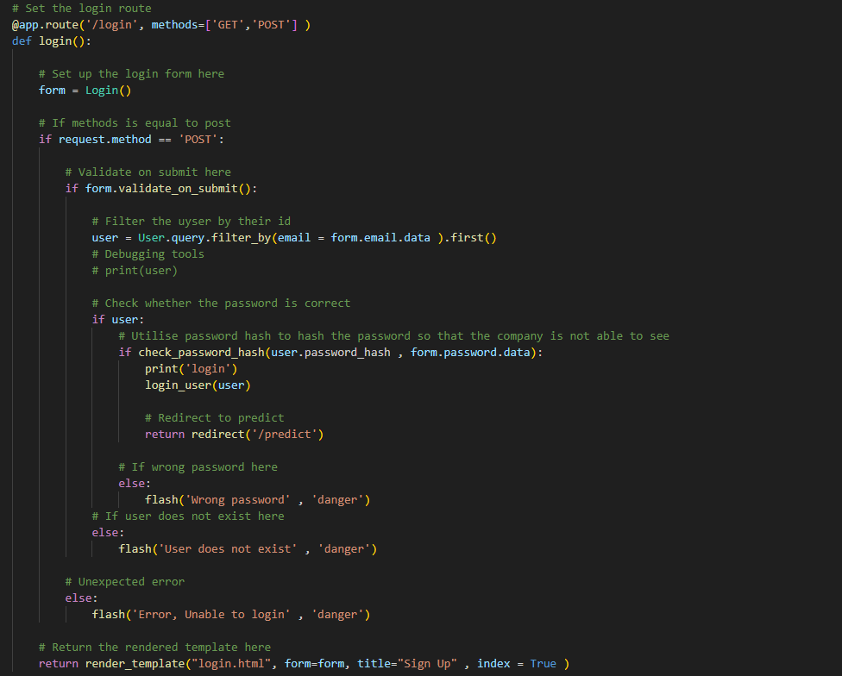
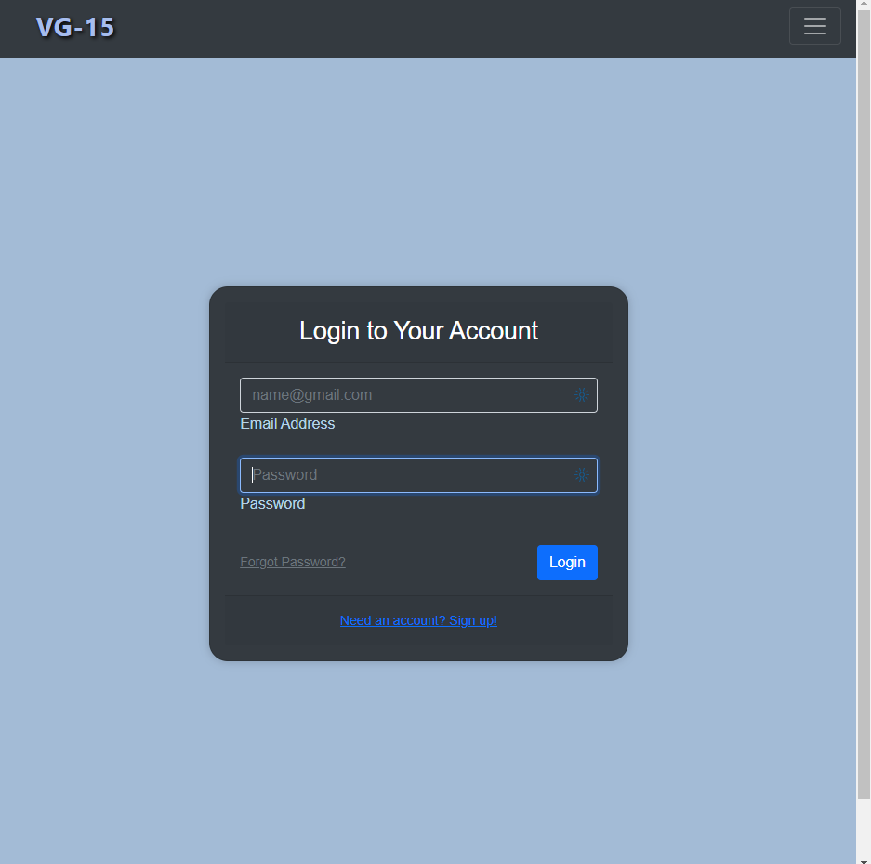
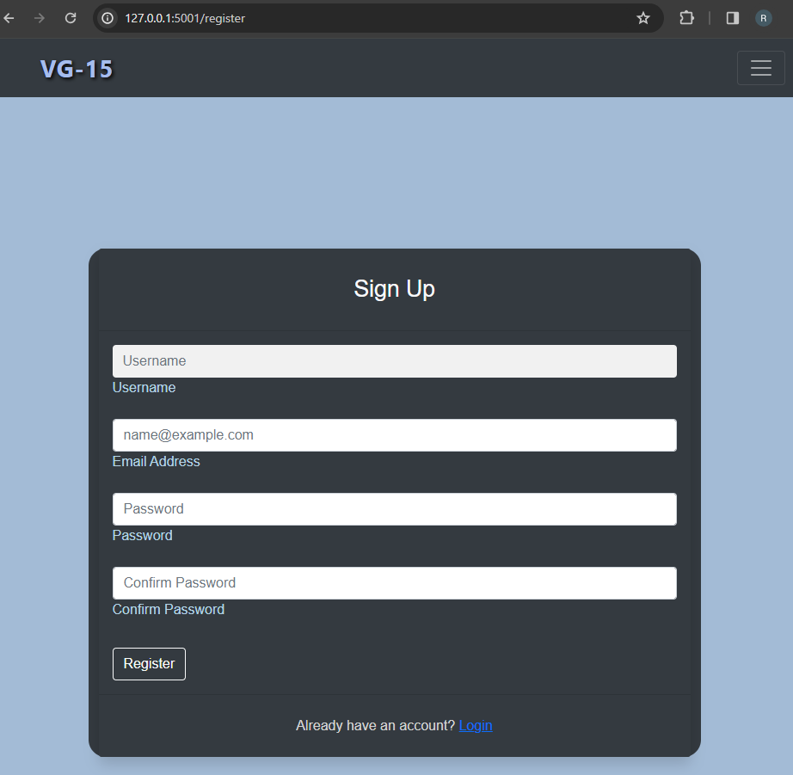
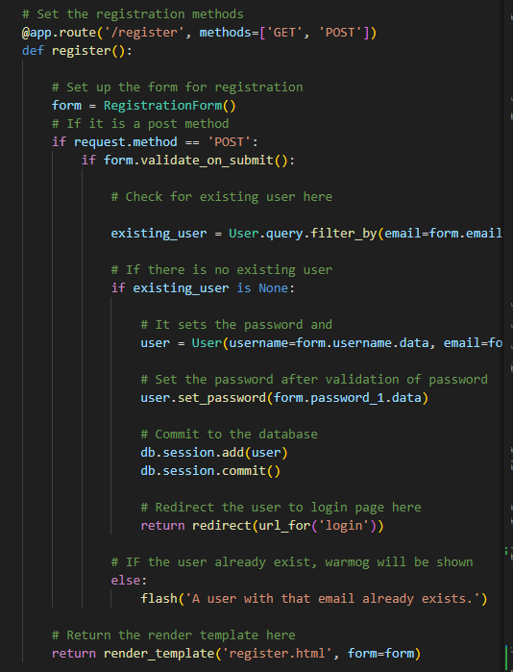
Web Development (Login and Sign up)
Login Page provides a clean and responsive look
It provides additional option for password resetting and all
Provides redirecting to register page if user has not log in before
Deployed with flask framework

Slide 15
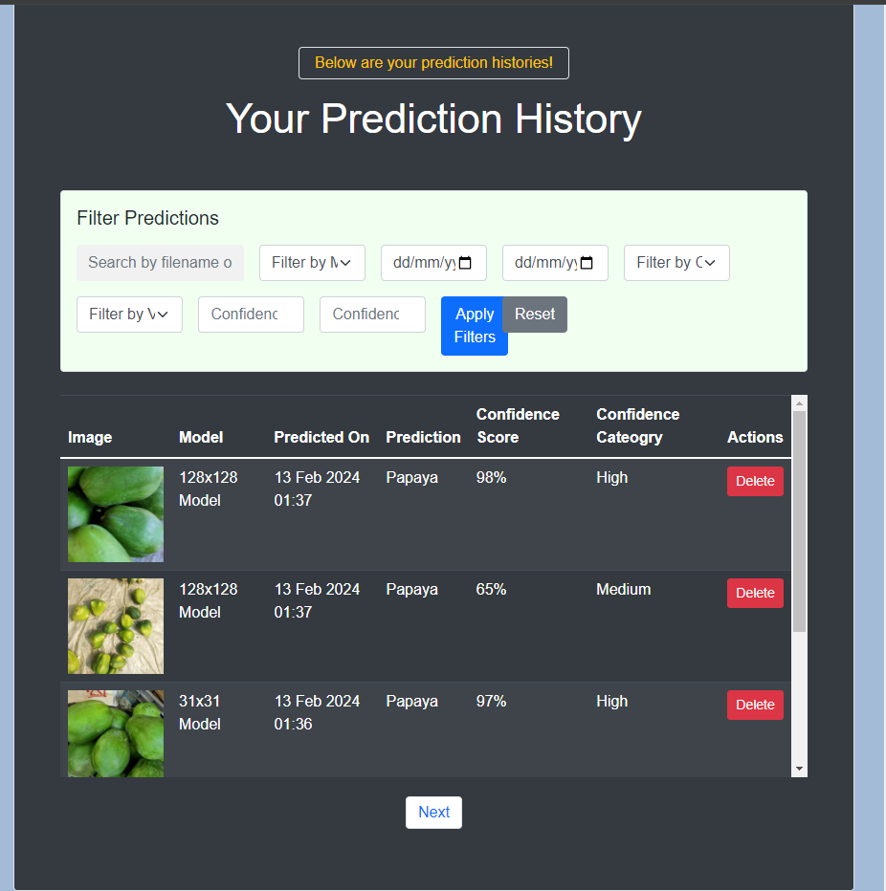
Web Page (History)
Prediction History was stored
Additional
Provide next and back option where each page only show 5 predictions
Providing searching and filtering function

Slide 16
Validity Testing
Non-Api
Test_add_prediction_entry_directly
Test entry are placed into database
Rest api test
Test_add_prediction_entry
Test entry that are place into the database with the use of api here
Test_api_get_entry
Test to validate getting the correct entries back
Test links
test link whether it is able to pass the test and the correct status code
Test_logged_in_links
Test the links after login can be access
test_predict_vegetable_type_big/small
Test for prediction of image here
Test_add_user
Test for adding user here
Test_user_login_api
Test for ability to login here

Slide 17
Expected Failure Testing
Non-Api
Test_email_exist
Test for duplicate emails
Rest api test
Test_missing_models
Test for missing models provided here
Test_missing_values
Test for missing
Test links
test link whether it is able to pass the test and the correct status code
Test_get_entry_404
Test whether able to get entry that are invalid
test_invalid credentials
Consistency Testing
Non-Api
Test_consistent_entry
Test for consistent entry of same data
Rest api test
Test_prediction_consistency
Test for continuous prediction here

Slide 18
Unexpected Failure Testing
Non-Api
Test_prediction_database
Unexpected database connection error to test app against database failures
Test_query_failure
Test for invalid queries
Range Testing
Non-Api
Test_prediction_confidence_r
Test for invalid confidence score
Test_prediction_userid
Test for invalid user id here

Slide 19
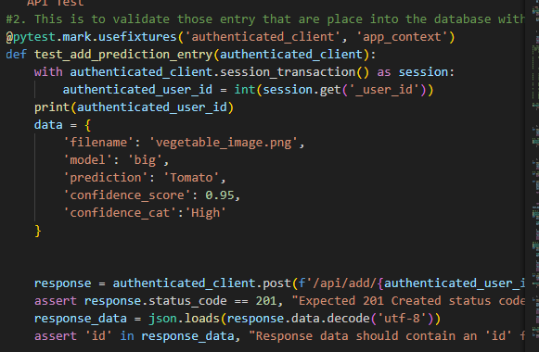
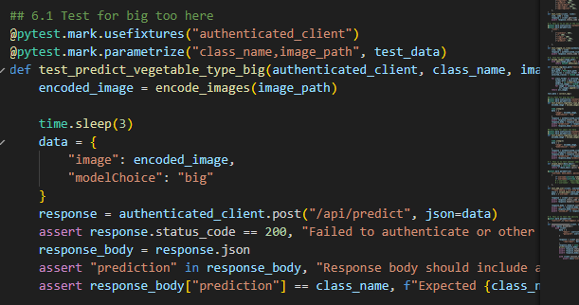
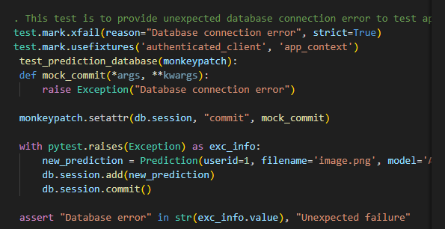
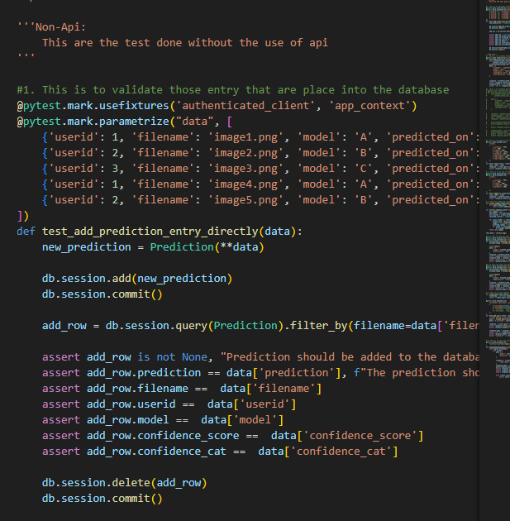
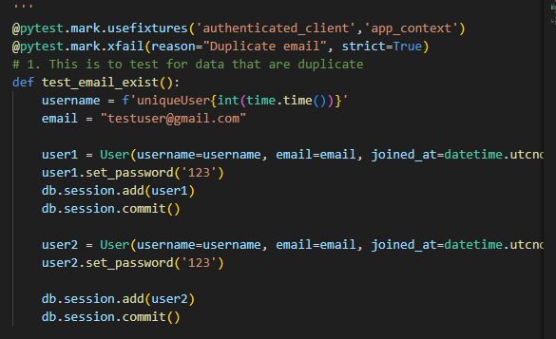
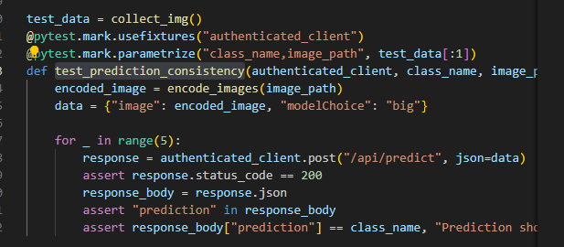
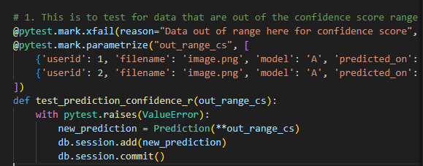
Some Examples
Test for validity
Test for validity
Test for unexpected f
Test for validity
Test for expected
Test for consistency
Test for range
And many many more…

Slide 20
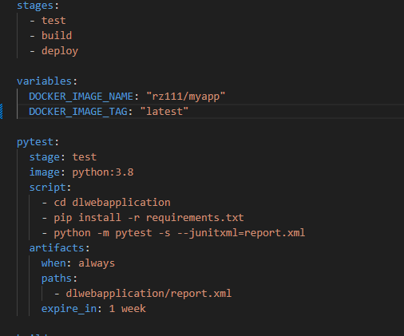
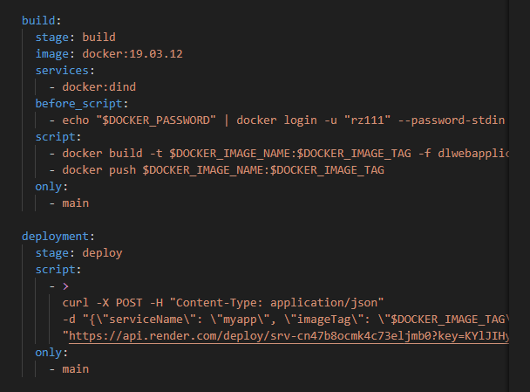
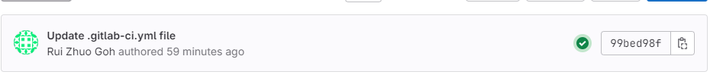
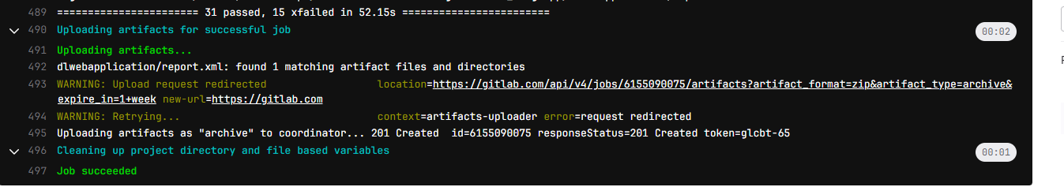
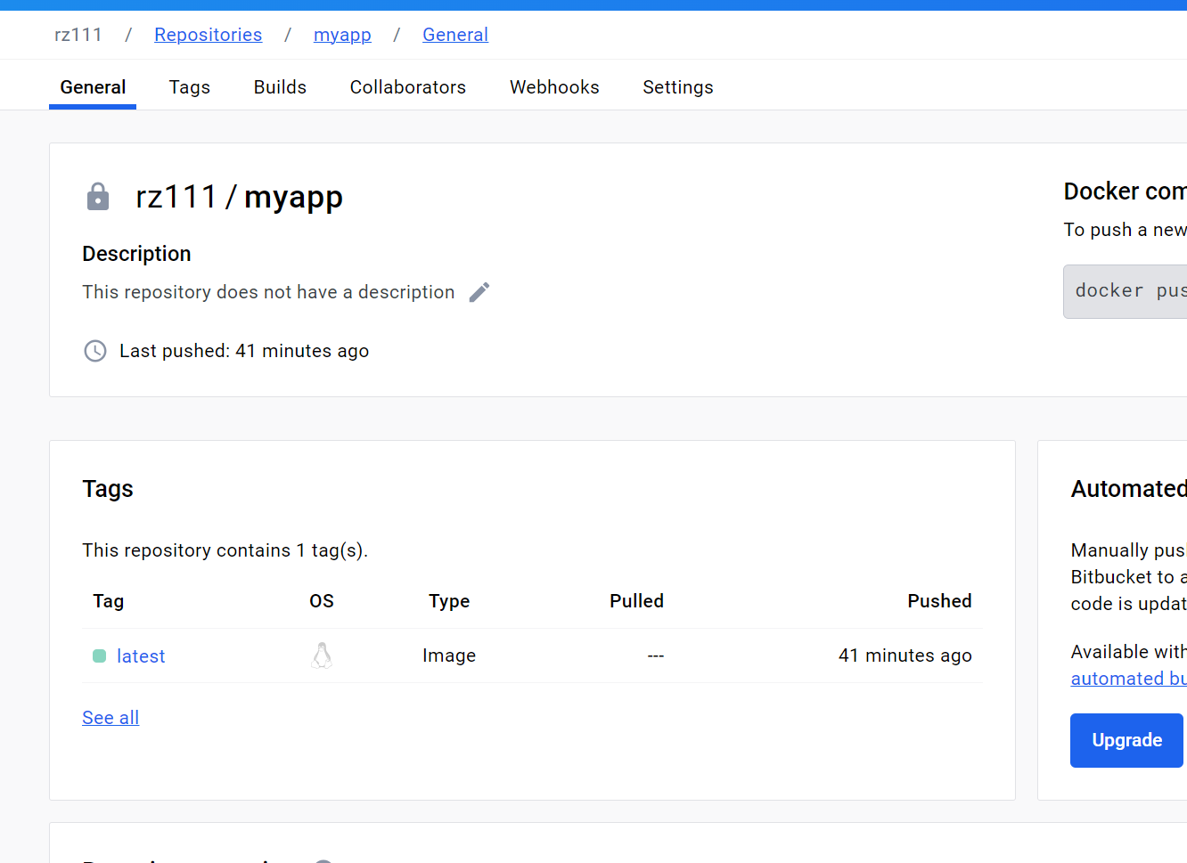
CICD Development
Continuous Integration here with the use of pytest
Continuous Deployment here with the use of docker hub and render
Deployed Image on docker hub
Provide better tracker
Better maintainability here with the use of docker image tag

Slide 21
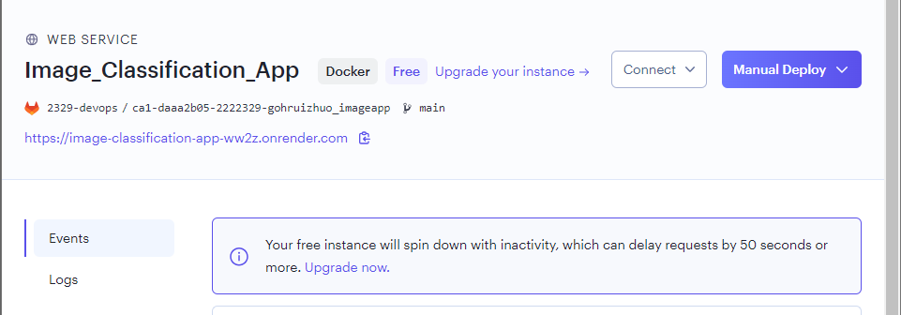
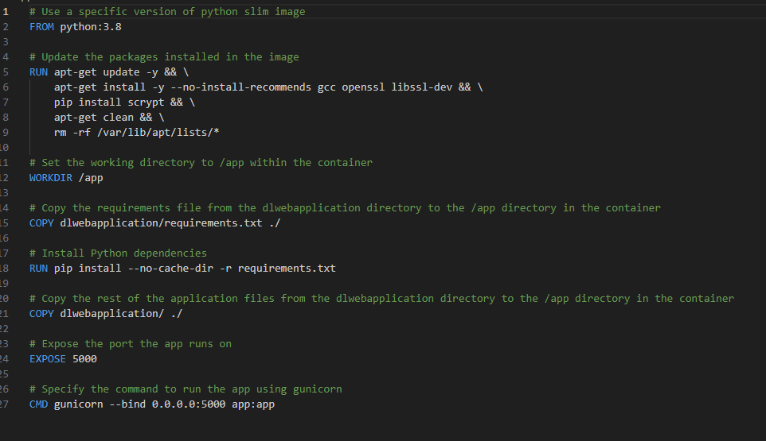

CICD Development
Deployed on render
https://image-classification-app-ww2z.onrender.com
Scan to access here

Slide 22
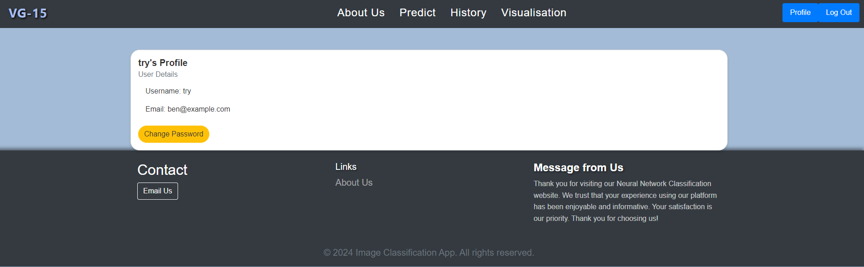
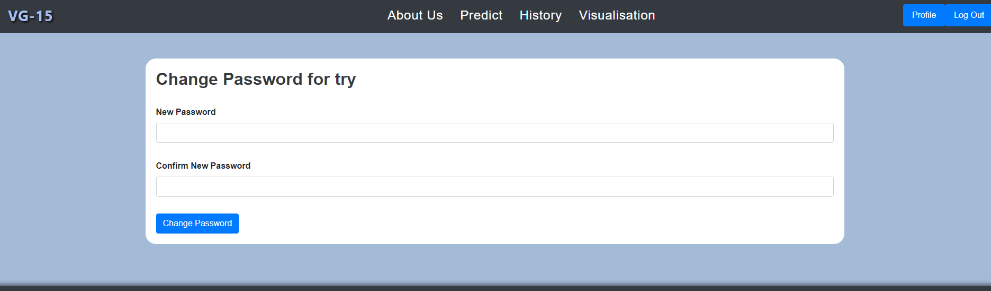
Additional Features
Created a user profile page that enables the change of password
Provision of change password
Provision of reset password

Slide 23
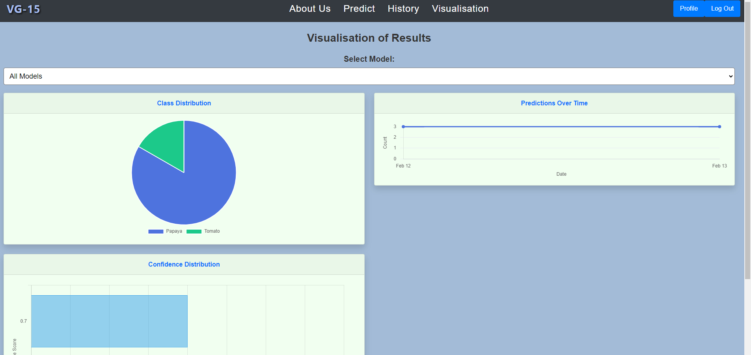
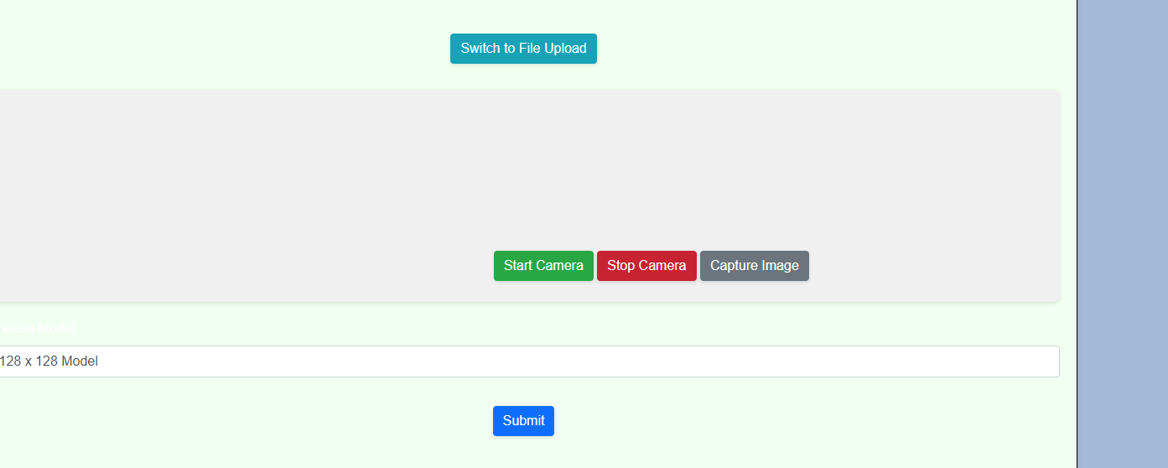
Additional Features
Provided visualisation page to visualisation results and habits here
Able to predict with the use of webcam here too

Slide 24
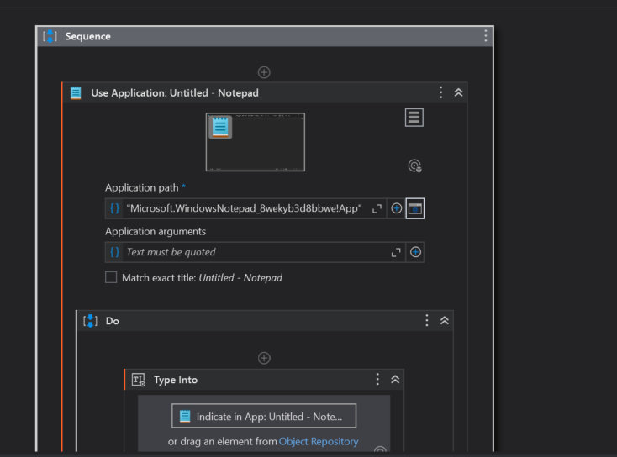
RPA
Provdie full testing automation
This test is from registration to login to prediction to log out
Below shows the workflow

Slide 25

RPA (Video)
THANK YOU

